Slide 1

YELP Restaurant stars prediction

Slide 2
Aim & Work Flow
AIM: Predict the stars of restaurants based on the accessible data
Work Flow:
Data cleaning
Data visualization
Model training
Predication

Slide 3
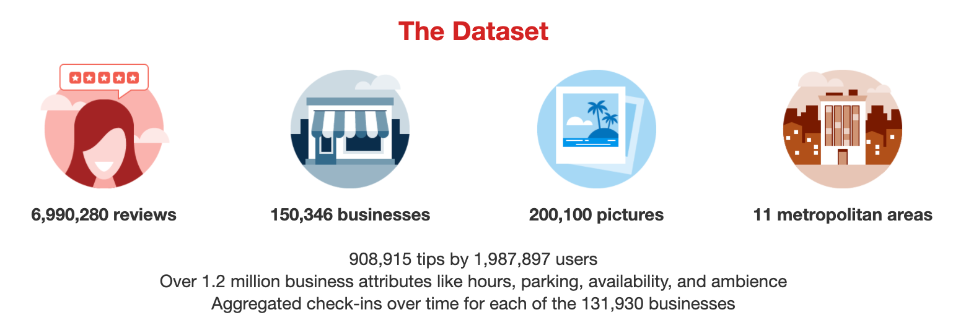
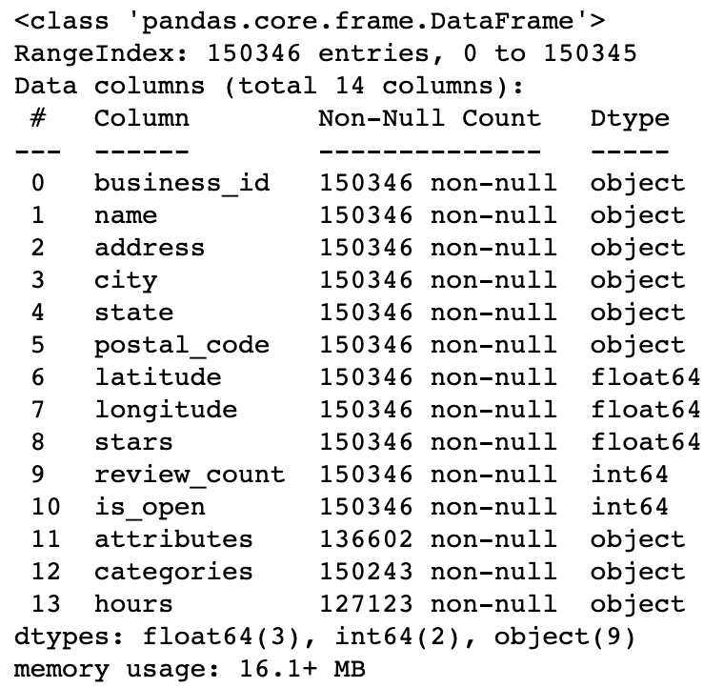
Data Cleaning
Compressed Columns
Redundant information
Missing data
Meaningless Dtype
Business other than restaurant
Data Source https://www.yelp.com/dataset/documentation/main

Slide 4
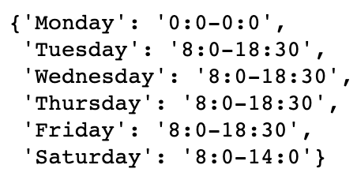
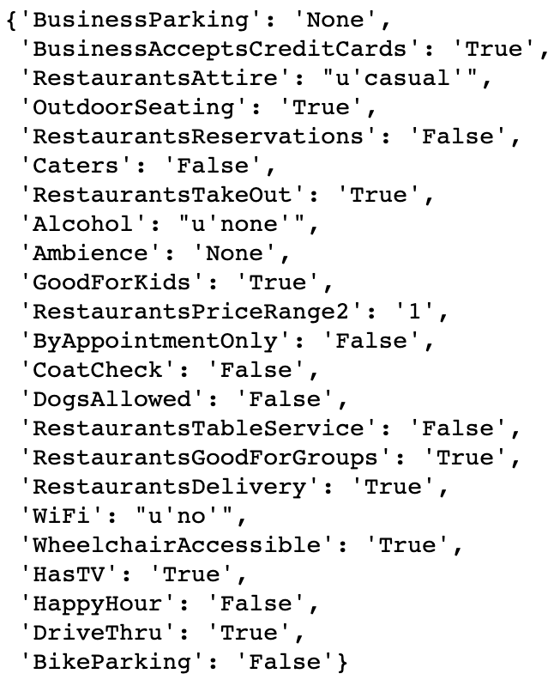
Unfold daily open and close time into 4 columns :
Average weekday open time
Average weekday close time
Average weekend open time
Average weekend close time
Unfold attributes into different columns and only keep those who are related to restaurant.
Hours
Attributes

Slide 5
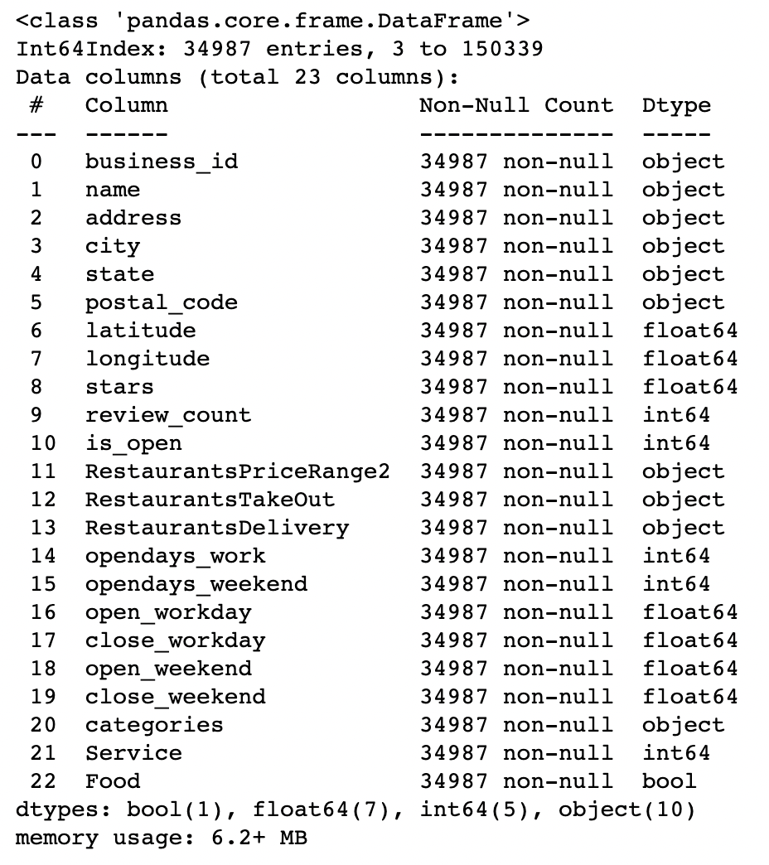
Is_open = True
Is restaurant = True
Drop meaningless and duplicate columns
Fill in missing data
For service, if the service column is None, suppose the restaurant does no have the certain service.
For opening time, if none, suppose open at 24 and close at 0

Slide 6
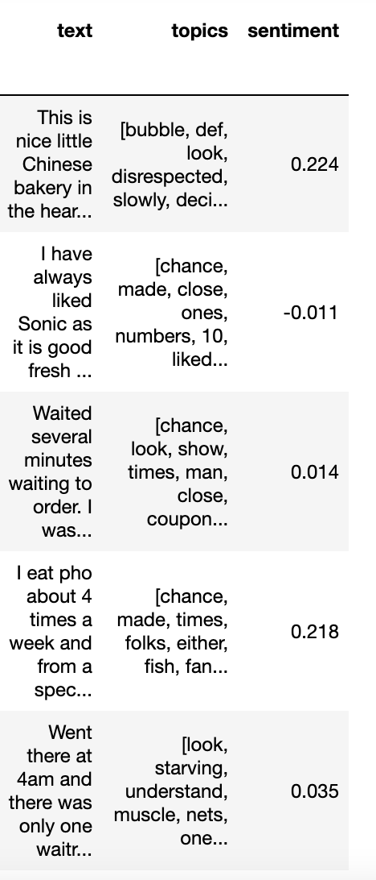
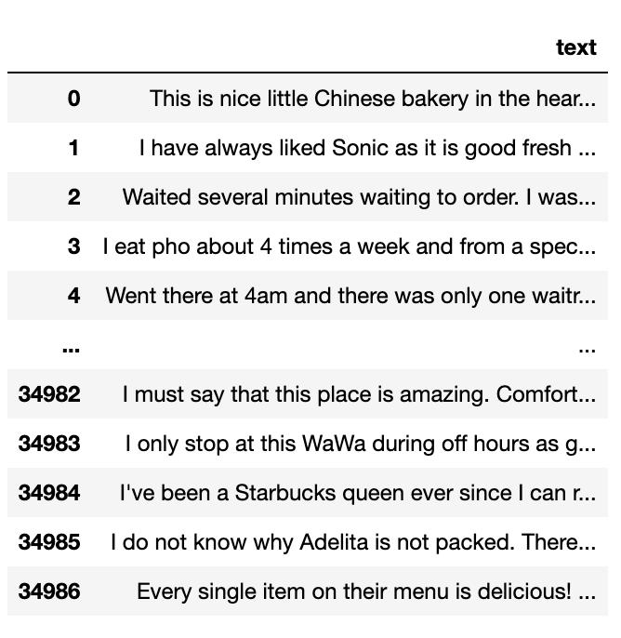
Sentiment score
-1 Most Negative
+1 Most Positive
“Topics”
Most frequent 5 words in each review used for tfidf

Slide 7
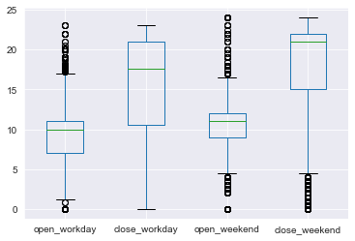
DATA VISUALIZATION Service Time

Slide 8
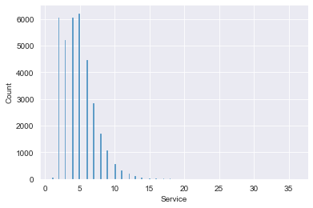
DATA VISUALIZATION Service Type I

Slide 9
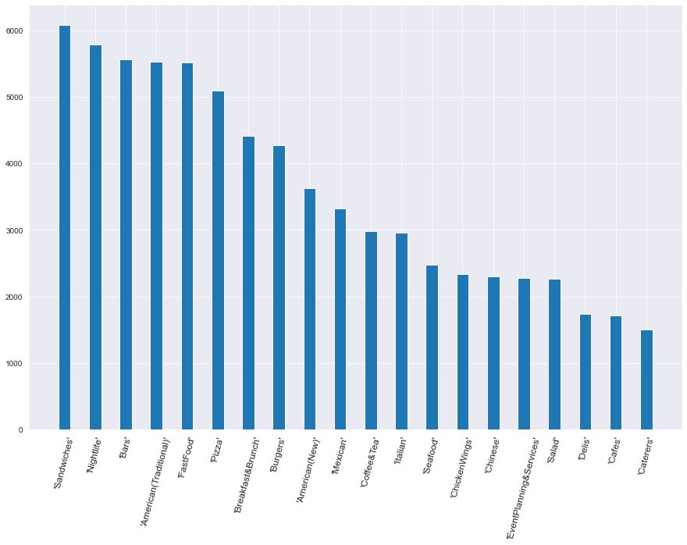
DATA VISUALIZATION Service Type II
Sandwiches Nightlife Bars American(Traditional) FastFood
Pizza Breakfast&Brunch Burgers American(New) Mexican
Coffee&Tea Italian Seafood ChickenWings Chinese
EventPlanning&Services Salad Delis Cafes

Slide 10
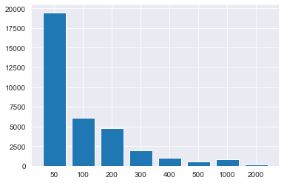
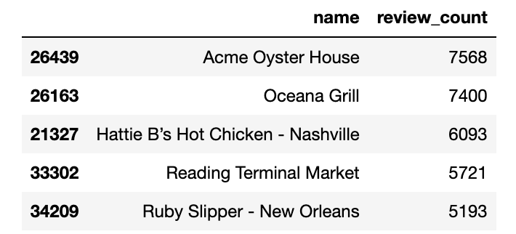
DATA VISUALIZATION REVIEWS

Slide 11
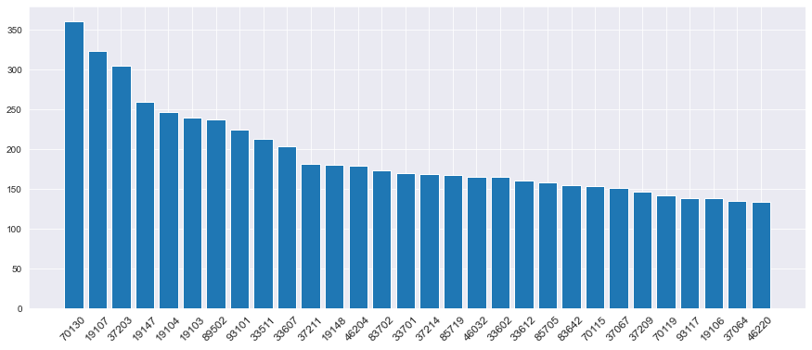
DATA VISUALIZATION LOCATIONS
70130 New Orleans, LA, California
19107 Philadelphia, Pennsylvania
37203 Nashville, Tennessee
19147 Philadelphia, Pennsylvania
19104 Philadelphia, Pennsylvania
19103 Philadelphia, Pennsylvania
89502 Reno, NV
93101 Santa Barbara, California
33511 Hillsborough County, Florida
33607 Tampa, Florida
37211 Nashville, Tennessee
19148 Philadelphia, Pennsylvania
46204 Indianapolis, Indiana
83702 Ada County, Idaho
33701 St. Petersburg, Florida
37214 Nashville, Tennessee
85719 Tucson, Arizona
46032 Hamilton County, Indiana
33602 Tampa, Florida
33612 Hillsborough County, Florida
85705 Pima County, Arizona
83642 Ada County, Idaho
70115 New Orleans, LA, California
37067 Williamson County, Tennessee
37209 Nashville, Tennessee
70119 New Orleans, Louisiana
93117 Santa Barbara County, California
19106 Philadelphia, Pennsylvania
37064 Williamson County, Tennessee
46220 Marion County, Indiana

Slide 12
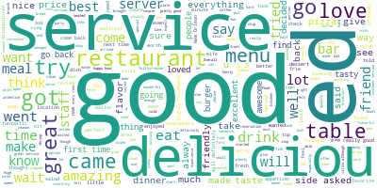
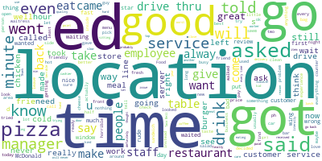
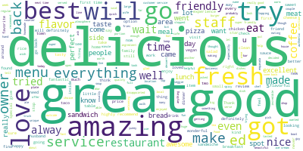
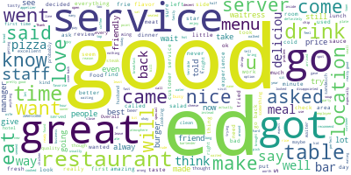
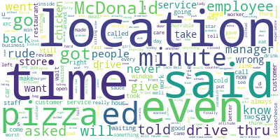
DATA VISUALIZATION Word cloud
4 stars
2 stars
5 stars
3 stars
1 star

Slide 13
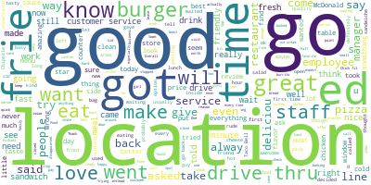
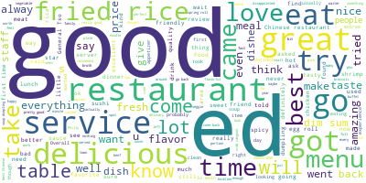
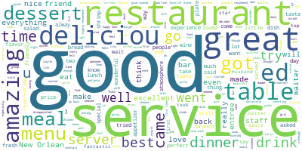
Topics in different restaurants
Fast Food
Chinese
French

Slide 14
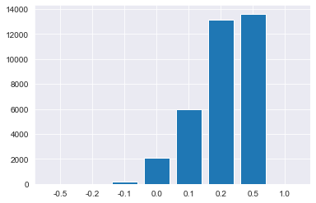
DATA VISUALIZATION sentiment

Slide 15
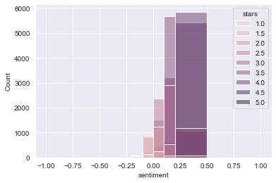
DATA VISUALIZATION sentiment

Slide 16
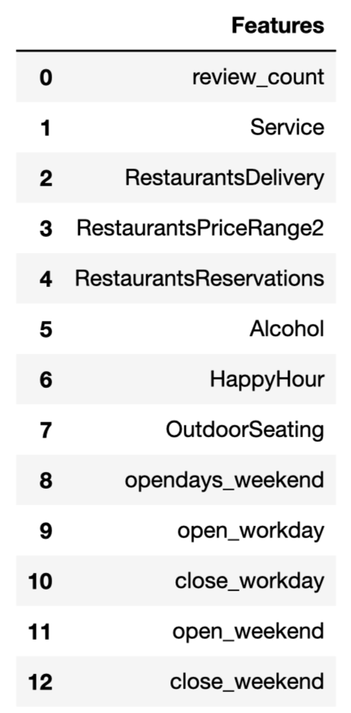
Methods(Without NLP methods)
Linear Regression
Decision Tree Regression
Gradient Boosting Regressor
Stacking Regressors
Gradient Boosting Classifiers
Random Forest Classifiers

Slide 17
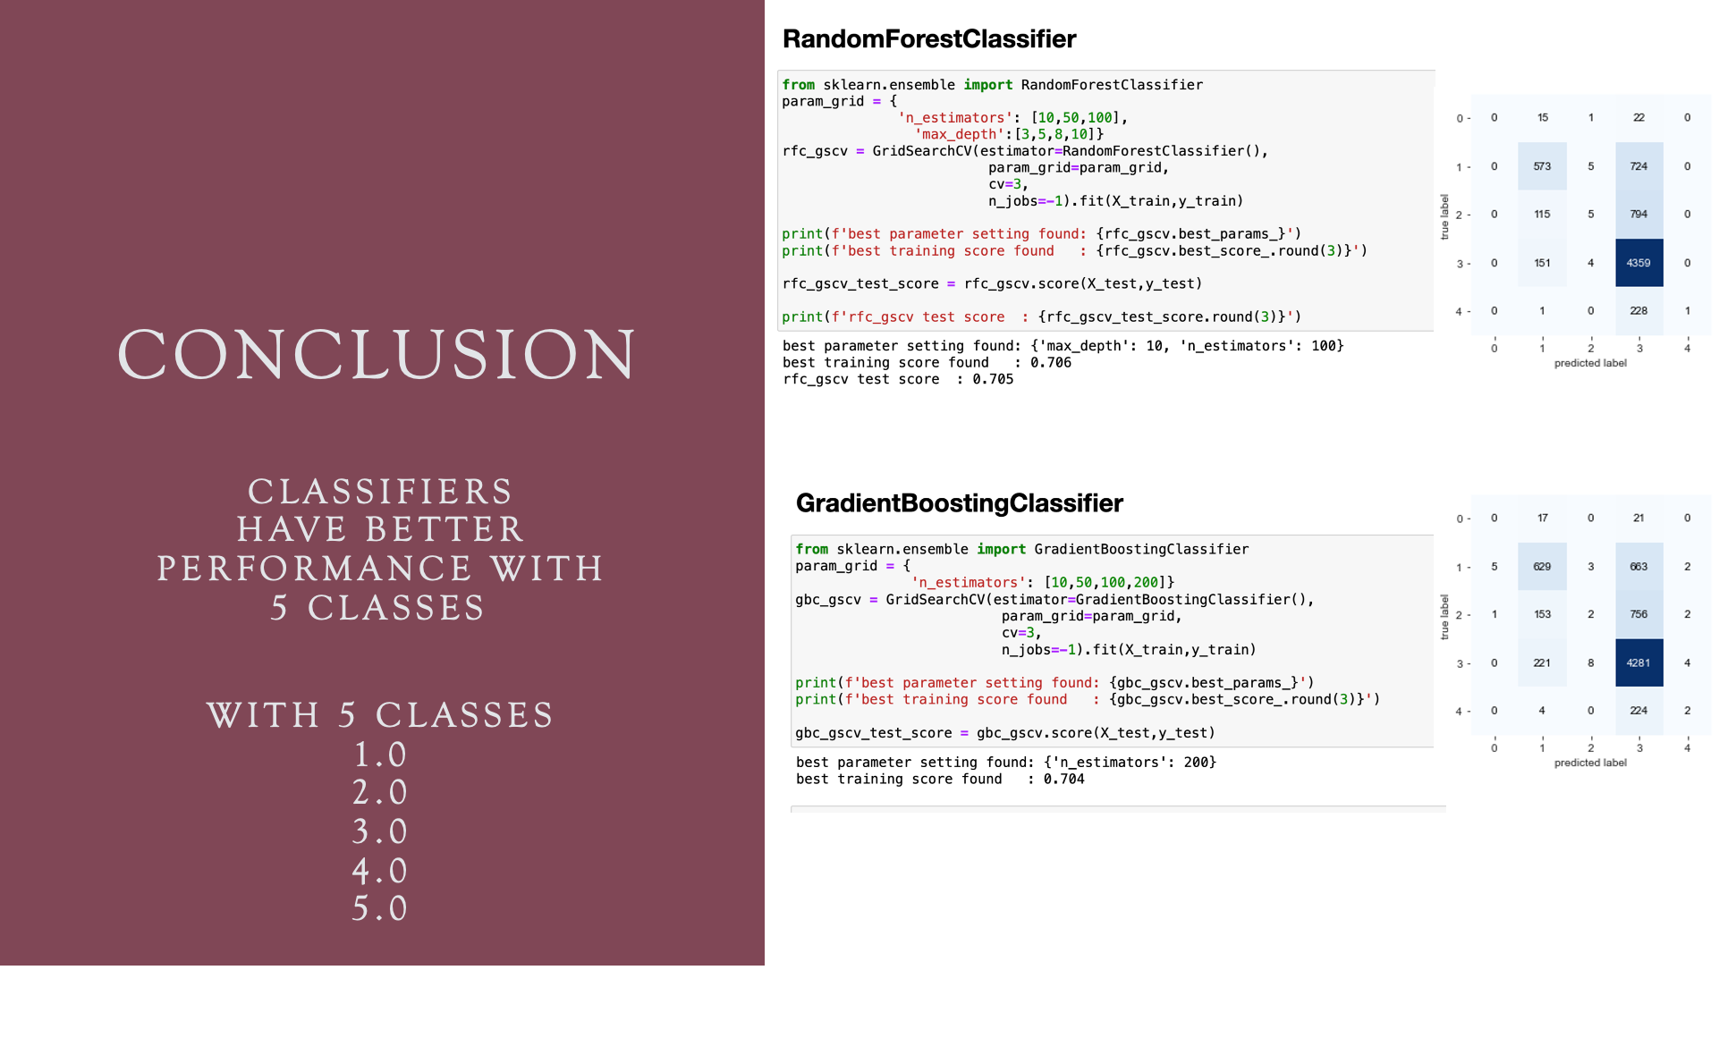

Slide 18
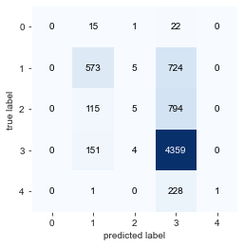
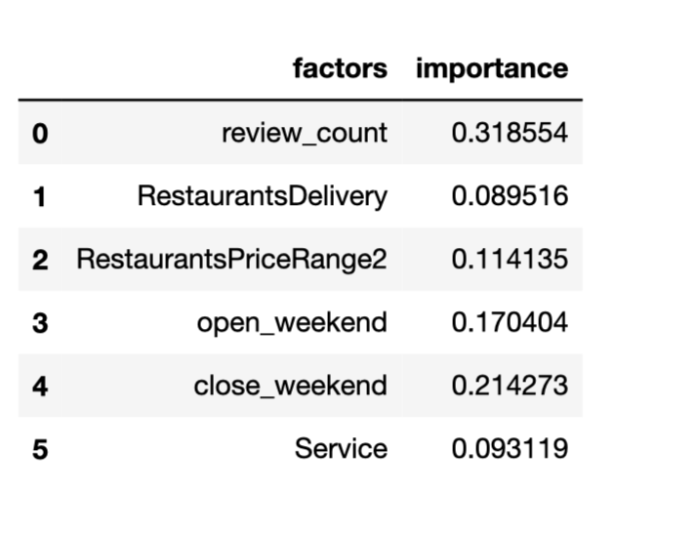
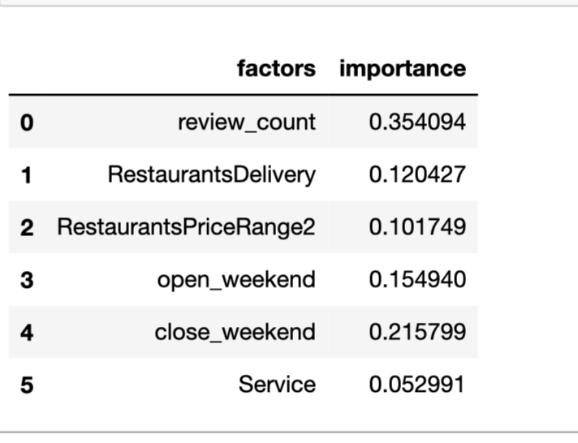

Conclusion classifiers have better performance with 5 Classes
Random Forest Classifiers
Gradient Boosting Classifiers
Restaurants should pay more attention to the above factors when they are trying to build reputation and get higher score. The most important factor is review counts followed by close time at weekend and open time at weekend.

Slide 19
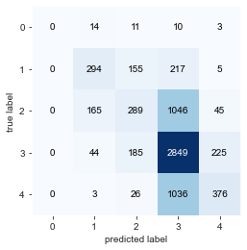
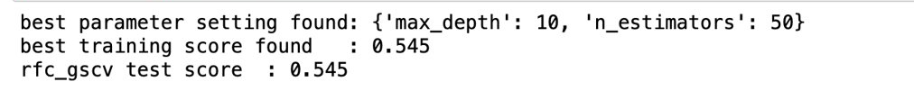
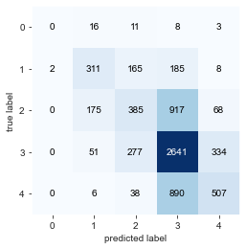
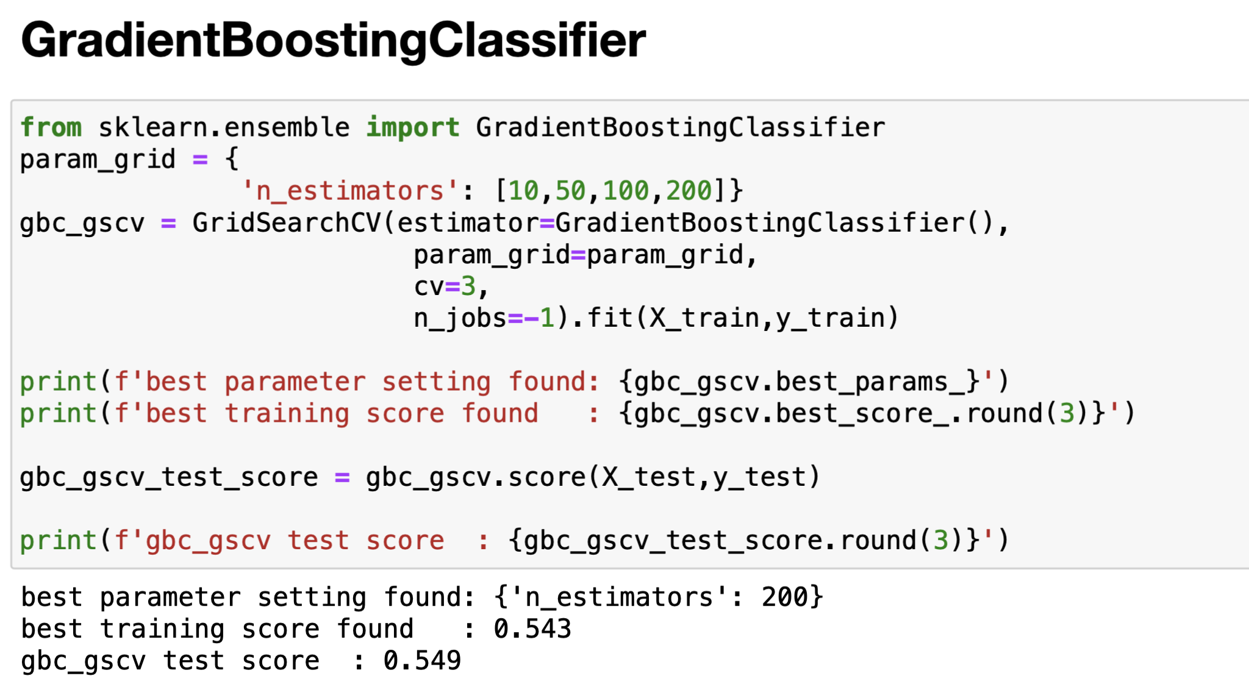
ROuND-HALF-UP classifiers have better performance with 5 Classes
Random Forest Classifiers
Gradient Boosting Classifiers

Slide 20
NLP Using Reviews of Restaurants
Bag of Words
Tf-Idf

Slide 21
DATA processing
Reviews for each restaurant
Bag of words for each restaurant
Tokenization
NLP
Calculate Top 5 frequent words for all
restaurants
Remove Stopwords
Tokens for each restaurant
Bag of words for each restaurant
Lemmatization
Filter by the set of frequent words
(4723)
Stemming
Bag of Words for each restaurant
Bag of words for each restaurant

Slide 22
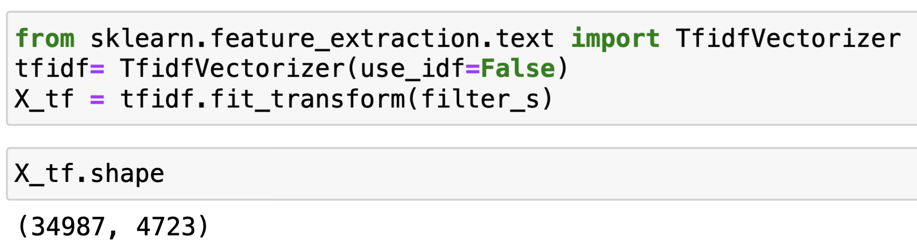
NLP
Use Bag of Words for each restaurant filtered by the most frequent used words and calculated the word frequency for each restaurant.
Use the transformed term frequency matrix for classification

Slide 23
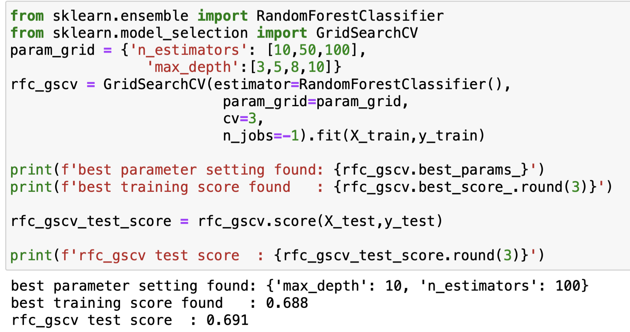
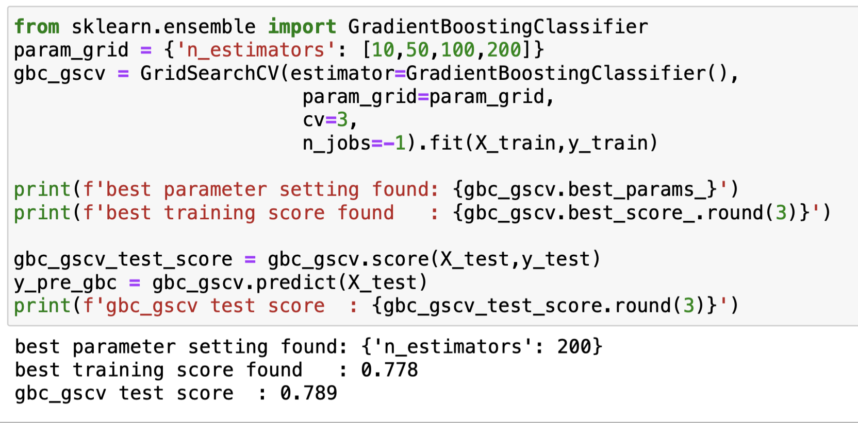
ROuND-HALF-UP classifiers have better performance with 5 Classes
Random Forest Classifiers
Gradient Boosting Classifiers

Slide 24
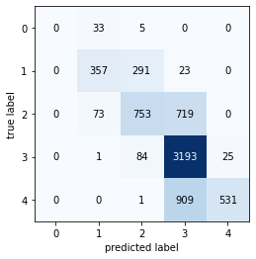
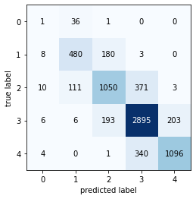
ROuND-HALF-UP classifiers have better performance with 5 Classes
Random Forest Classifiers
Gradient Boosting Classifiers

Slide 25
NLP
Apply Tf-Idf measurement to all the text reviews for each restaurant. We keep words occur in at least 5 documents and at most 80% of documents, use tokens of at least 2 characters and use only unigrams. So, we create a vector with 109100 columns to each restaurant. And apply:
Linear Regression
Decision Tree Regressor
Decision Tree Classifier
Gradient Boosting Classifier
Gradient Boosting Regressor
using rating as response variable, and make pipeline for each.

Slide 26
NLP
Regressor | Accuracy
Linear Regression | 0.66
Decision Tree Regressor | 0.51
Decision Tree Classifier | 0.72
Gradient Boosting Classifier | 0.81
Gradient Boosting Regressor | 0.81

Slide 27
Sentiment analysis
Based on the sentiment score, we can also train models to find the relation between it and ratings and predict ratings using sentiment scores.
The correlation between the two variables are 0.88, so we can build models on them.
We apply same methods on NLP

Slide 28
Sentiment analysis
Regressor | Accuracy
Linear Regression | 0.78
Decision Tree Regressor | 0.79
Decision Tree Classifier | 0.81
Gradient Boosting Classifier | 0.82
Gradient Boosting Regressor | 0.79

Slide 29
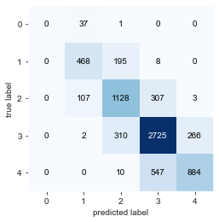

WIth Sentiment classifiers have better performance with 5 Classes
Random Forest Classifiers
Test score: 0.55
Test score: 0.74
Gradient Boosting Classifiers
Test score: 0.55
Test score: 0.75

Slide 30
Conclusion
NLP and sentiment analysis works better on predicting the rating of a restaurant.
But the two methods need some customer reviews. If the restaurant does not get certain amount of the reviews, the owner
can adjust the service based on the feature
importance from the Gradient Boosting Classifier on the
restaurant attributes to get better ratings.

Slide 31
Thanks for your listening

